Slide 1
Intermediate Representations Problems Chapter-5
Amrita School of Engineering, Bengaluru
Amrita Vishwa Vidyapeetham

Slide 2
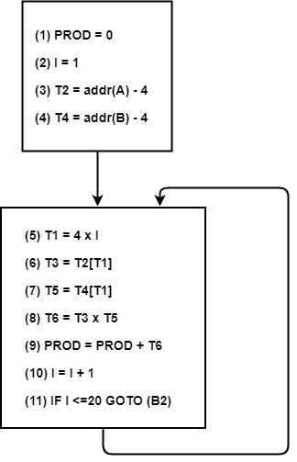
Problems
1. Convert the following to CFG
(1) PROD = 0
(2) I = 1
(3) T2 = addr(A) – 4
(4) T4 = addr(B) – 4
(5) T1 = 4 x I
(6) T3 = T2[T1]
(7) T5 = T4[T1]
(8) T6 = T3 x T5
(9) PROD = PROD + T6
(10) I = I + 1
(11) IF I <=20 GOTO (5)
B1
B2

Slide 3
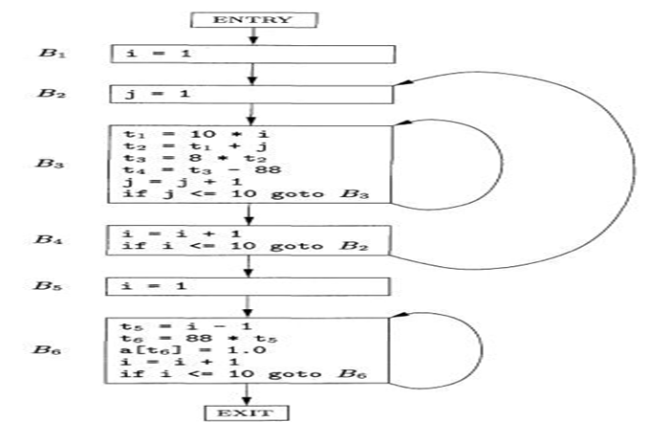
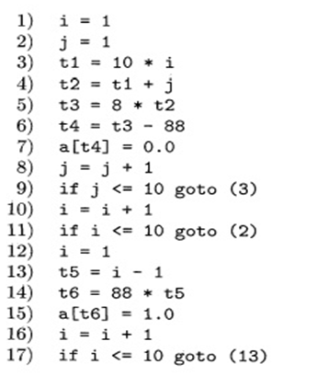
Problems
2. Convert the following to CFG

Slide 4
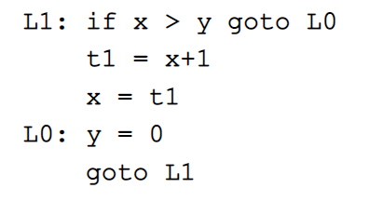
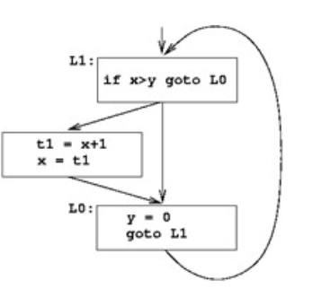
3. Convert the following to CFG

Slide 5
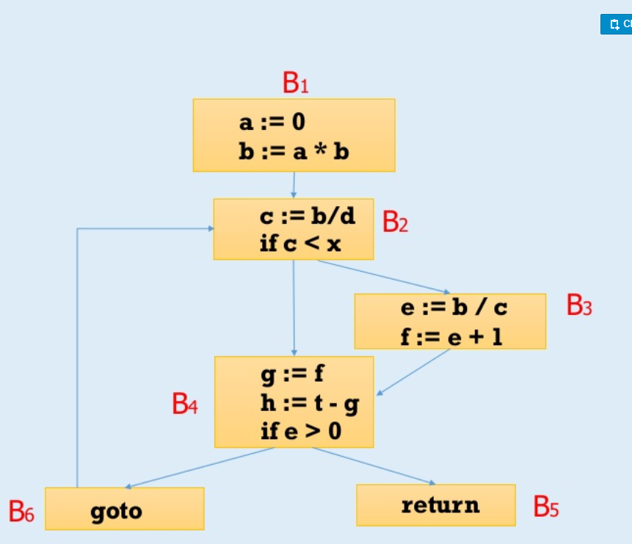
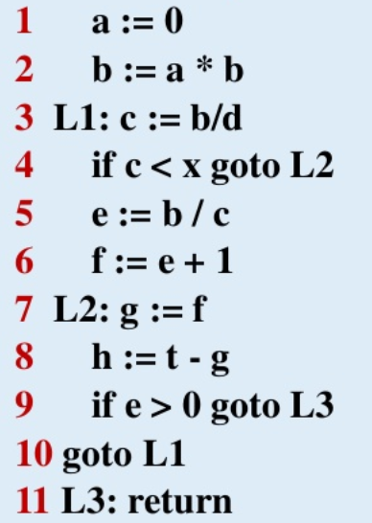
4 Convert the following to CFG
B2

Slide 6
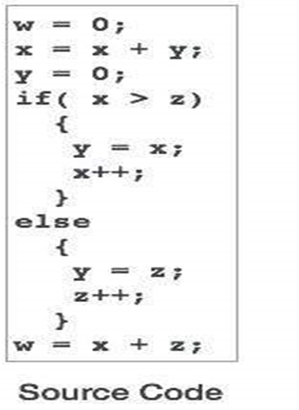
5. Convert the following to CFG

Slide 7
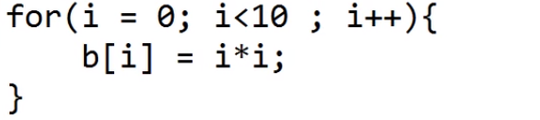
Problems
Convert the following to 3-address code
1.
2.
3.
for(i = 1; i<=10; i++)
{
a[i] = x * 5;
}

Slide 8
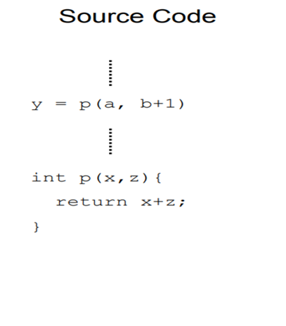
4

Slide 9
Problems
1. Convert the following stmt to 3-address code
for(i = 1; i<=10; i++)
{
a[i] = x * 5;
}
3-address code
i=1
L2 : If i>10 goto L1
t1=x * 5
a[i]=t1
t2=i+1
i=t2
goto L2
L1:

Slide 10
Problems
2. Convert the following stmt to 3-address code
3-address code
i=0
L2 : If i>=10 goto L1
t1=i*i
b[i]=t1
t2=i+1
i=t2
goto L2
L1:

Slide 11
Problems
3. Convert the following 3-address code
3-address code
dot_prod=0
i=0
L2 : If i>=10 goto L1
t1=a[i]
t2=b[i]
t3=t1 * t2
t4= dot_prod + t3
dot_prod=t4
i = i+1
goto L2
L1:
int a[10],b[10],i,dot_prod=0
for(i=0;i<10;i++)
dot_prod+=a[i]*b[i]

Slide 12
Problems
4. Convert the following to 3-address code
3-address code
………
t1=a
t2=b+1
call p, t1, t2
………
funcbegin p
param x
param z
t3=x+z
return t3
funcend

Slide 13
Problems
1. Convert the following to SSA

Slide 14
Problems
2. Convert the following to SSA

Slide 15
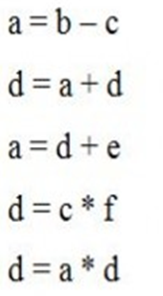
Problems
3. Convert the following to SSA
SSA
a1 = b1 – c1
d2 = a1 + d1
a2 = d2 + e1
d3 = c1 * f1
d4 = a2 * d3

Slide 16
Problems
4. Convert the following to SSA
SSA

Slide 17
Problems
5. Convert the following to SSA
SSA

Slide 18
Problems
6. Convert the following to SSA
SSA

Slide 19
Problems
7. Convert the following to SSA
SSA

Slide 20
Problems
SSA
B1
i1 ← 1
j 1← 1
k1← 0
8. Convert the following to SSA
i=1;
j=1;
k=0;
while(k<100)
{
if(j<20)
{
j=i;
k=k+1;
}
else
{
j=k;
k=k+2;
}
}
return j;
}
j2 ← φ(j4,j1)
k2 ← φ(k4,k1)
if k2<100
B2
B3
if j2<20
return j2
B4
B5
j 3← i1
k3 ← k2+1
B6
j 5← k2
k5 ← k2+2
B7
j4= φ(j3,j5)
k4 ← φ(k3,k5)

Slide 21
Problems
9. Convert the following to SSA

Slide 22
CFG
SSA

